Slide 1
PROGRAMMING FOR PROBLEM SOLVING
SEMESTER:1ST CE/IT
PREPARED BY: Prof. Murti Patel

Slide 2
CHAPTER 5 : FUNCTIONS TOPIC 8 : MACROS
segment of code which is replaced by the value of macro
defined by #define directive
It’s syntax is:
#define <macro_name> <token>
Here the token can be any text and macro_name can be any valid C name.

Slide 3
TYPES OF MACRO
Macros
Object Like Macros
Function like Macros

Slide 4
OBJECT LIKE MACROS
is an identifier that is replaced by value. It is widely used to represent numeric constants.
For example:
#define PI 3.1415
Here, PI is the macro name which will be replaced by the value 3.14.
Let's see an example of Object-like Macros :
#include <stdio.h>
#define PI 3.1415
main()
{ printf("%f",PI); }

Slide 5
FUNCTION LIKE MACROS
The function-like macro looks like function call.
For example:
#define MIN(a,b) ((a)<(b)?(a):(b))
Here, MIN is the macro name. Let's see an example of Function-like Macros :
#include <stdio.h>
#define MIN(a,b) ((a)<(b)?(a):(b))
void main()
{
printf("Minimum between 10 and 20 is: %d\n", MIN(10,20)); }

Slide 6
WHAT IS PRE-PROCESSOR ???
process the source code before it is passed to the C compiler.
It is not a part of the compiler, but is a separate step in the compilation process
It is just a substitution tool and instructs the compiler to perform certain processes needed before doing the actual compilation.

Slide 7
WHAT IS PRE-PROCESSOR DIRECTIVES ???
Pre-processor provides several features called pre-processor directives.
All these pre-processor commands begins with hash (#).
Following slide contains different directive.

Slide 8
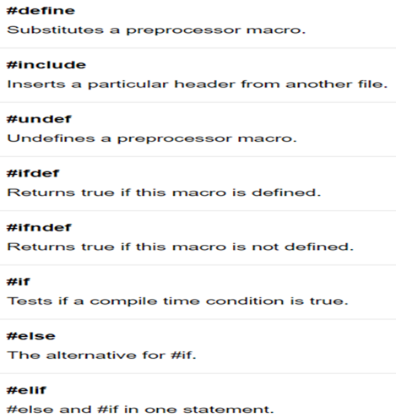
PRE-PROCESSOR DIRECTIVES

Slide 9
How pre-processor works ???
C Program
Are there any pre-processor directives?
No
Perform actual compilation
Yes
Pre-processing actions required

